Slide 1


CTI – Printout Invoice
Solution Design Guide
Author | Louis
Creation Date | 10-Mei-2021
Last Update | -
Document Ref | -
Ver. | 1.0
Antonius Wimawan
Yanuar Nukhan Wijayanto

Slide 2

CTI – Printout Invoice
Louis Darmawan
Mei 10, 2021

Slide 3
Background
Citramasjaya Teknikmandiri requires an Invoice template according to the Invoice Transaction.

Slide 4
Objective
To show invoice templates consisting of collect payment from the Job progress based on templates provided by Citramasjaya Teknikmandiri.

Slide 5
Standard NetSuite Printout Invoice

Slide 6
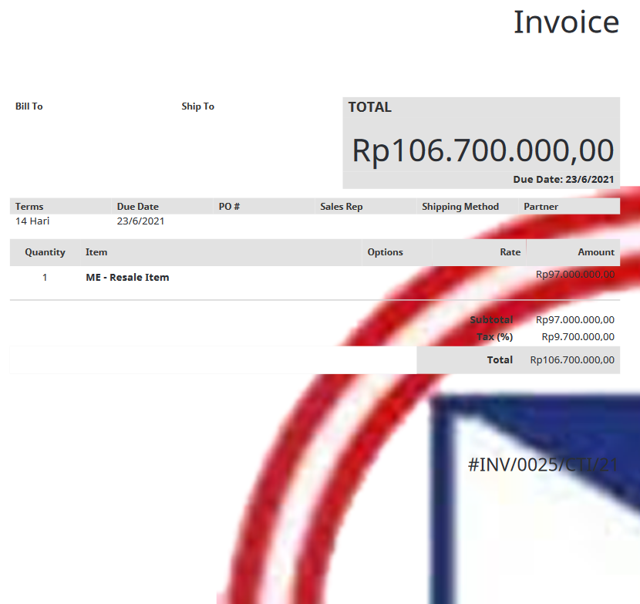
Standard Printout Purchase Order NetSuite

Slide 7
Existing Printout

Slide 8
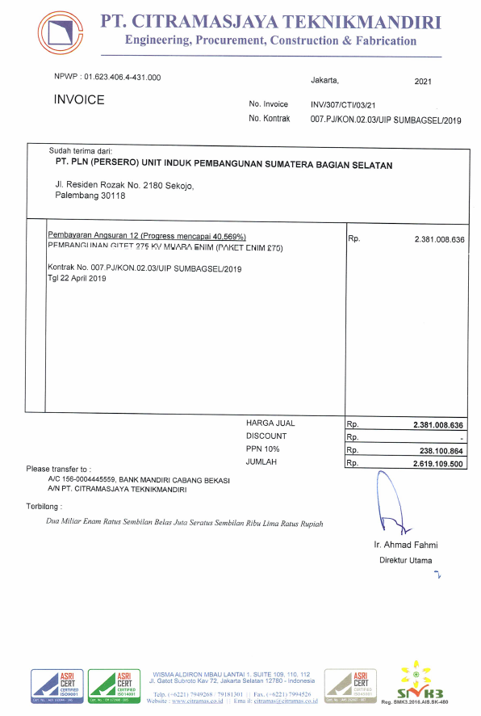

Slide 9
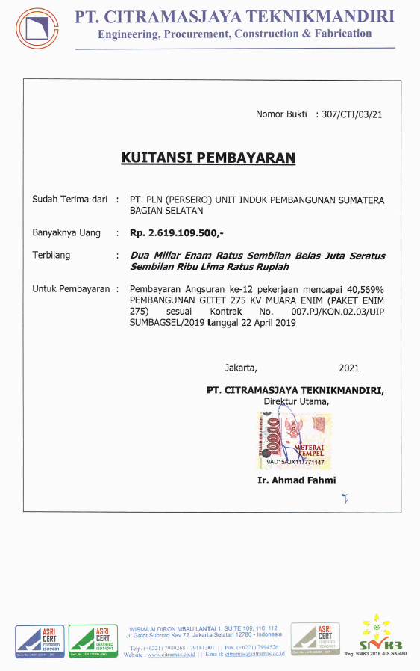

Slide 10
Requirement to SDG

Slide 12
Requirement
To design the invoice template above, it takes several steps, namely :
Create new template/custom Printout Invoice
Step : Customization → Advanced PDF/HTML Template
Add New Template for Citramasjaya Teknikmandiri Standard Printout Inventory Form.
Adjust the fields in the invoice printout template. There are several fields that must be entered by Source :
<Tax Reg Number> : Tax Registration Number/ Customer NPWP
<Date YYYY> : Year Created from Invoice Transaction
<Invoice Doc Number> : Invoice Transaction Number
<Contract No.> : Contract Number From Job Order Field
<Customer> : Customer Name
<Customer Address 1> : Customer Address Information
<Printout Memo> : Custome Record Note from Invoice Transaction

Slide 13
Requirement (cont.)
Cont. :
<Job Order Date> : Job Order Transaction Date
<Amount> : Amount total of all Item Lines
<Sub Total> : Amount total of all Item Lines
<Discount Item> : Discount Item ( “-” if don’t have Value)
<Tax> : VAT Tax Code 10% or Non VAT Tax Code 0%
<Total> : Total From Sub Total + Discount item + Tax
<Terbilang Dari Total> : Description From Total
<Approval Printout> : Approval name Free Text (Custome Record)
<Approval Job Position> : Approval Job Position in Hierarch Free Text (Custome Record)

Slide 14
Requirement
To design the Kuitansi template above, it takes several steps, namely :
Adjust the fields in the Kuitansi printout template. There are several fields that must be entered by Source :
<INV Doc No, Custom> : Invoice Transaction Number without INV.
Exp, INV/307/CTI/03/21 -> 307/CTI/03/21.
<Customer> : Customer Name
<Total> : Total From Sub Total + Discount item + Tax
<Terbilang Dari Total> : Description From Total
<Printout Memo> : Custome Record Note from Invoice Transaction
<Contract No.> : Contract Number From Job Order Field
<Job Order Date> : Job Order Transaction Date
<Date YYYY> : Year Created from Invoice Transaction

Slide 15
Requirement (cont.)
Cont. :
<Approval Job Position> : Approval Job Position in Hierarch Free Text (Custome Record)
<Approval Printout> : Approval name Free Text (Custome Record)

Slide 16
Requirement (cont.)
Cont. :
Other Information beside the source of the transaction Form is Hardcode

Slide 17
Notes
Please advice the possibility to develop this prototype scenario and possibility to be demonstrated to customer
Please advice that other item transaction will not be impacted or i should provide separate demo account

